Slide 1
Introduction
The Project Lean Canvas focuses on the hypothesis that a project or epic is trying to prove.
Uses whiteboards and sticky notes to encourage participation and collaboration
Drives the creation of the Lean Business Case (LBC) and is developed with a group of stakeholders working collaboratively.
Avoid developing the canvas in isolation
Ensure good representation and engagement from a broad range of stakeholders (Business, Project Management, Architecture, etc.).

Slide 2
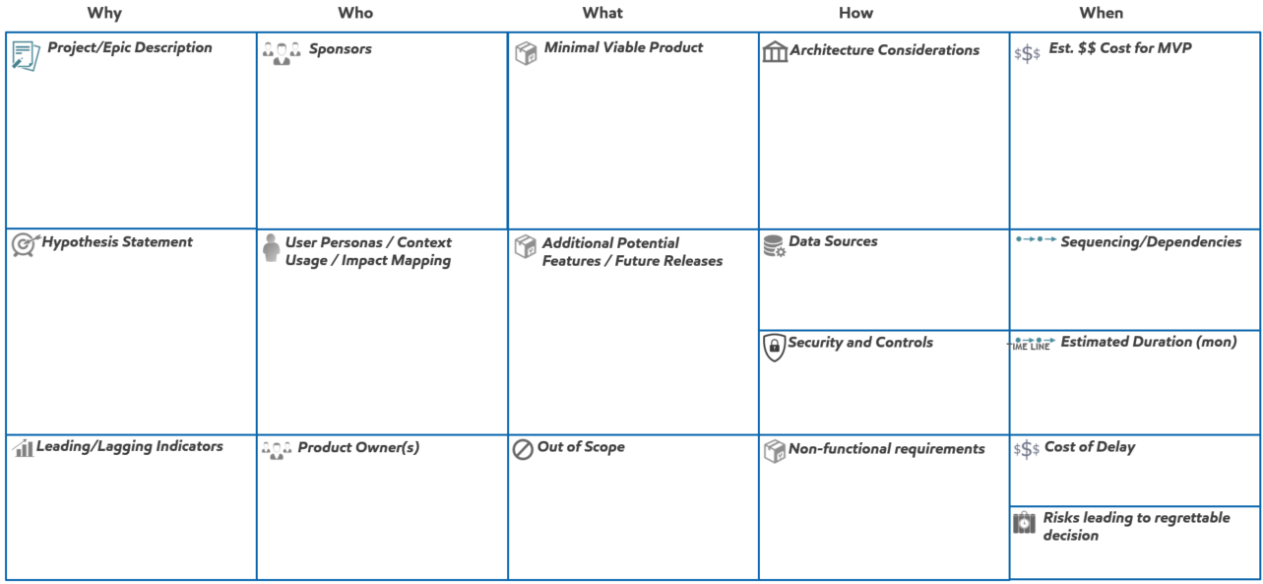
Introduction
Why
The fundamental question for any project to answer is “Why must we improve”? This is the “call to action” for making change and needs solid commitment and buy-in from all participants.
What
Answering the question of “what” explains the specific deliverables that will be created.
How
As a solution idea is explored it’s important to keep have some understanding of “how” to effectively implement this idea.
When
Most project requests pivot to fundamental questions of “How much will it cost” and “When will it be done”.
Who
Who will the project benefit and who will it affect? Those receiving benefits should be prepared to champion the project and engage those who will be affected.

Slide 3
Introduction
4. Sponsors
Sponsors agree with what is being improved and sign-up for realizing the benefits from the improvements. They understand not only the benefits measured but also how these benefits will be captured.
1. Project/Epic Description
What is the project about? How would you describe it to someone interested in understanding more?
2. Hypothesis Statement
The hypothesis statement describes what the project is attempting to prove. It should describe how things will be different from where they are now.
3. Leading/Lagging Indicators
Indicators support the business value generated by the project. These should be specific and measurable. Lagging indicators specify what the project will accomplish, these are usually found in the hypothesis. Leading indicators provide early signals on whether the lagging indicators will be accomplished.
5. User Personas / Context Usage / Impact Mapping
Understanding the types of users (or personas) and the context in which they will use the solution will help identify the scope and Minimal Viable Product.
Impact mapping is valuable in determining how the solution needs to change behaviors to maximize the impact of the solution.
6. Product Owner(s)
Identifying the product owner(s) will help determine who to engage to work on delivering the solution.

Slide 4
Introduction
7. Minimum Viable Product
The Minimal Viable Product (MVP) is the smallest amount of functionality that can be delivered into production that will provide value. From an investment perspective think of this as what you will get for the investment being made.
10. Architecture Considerations
Implementing solutions in a global enterprise requires some consideration of how the solution can leverage existing investments or align with emerging architecture considerations.
11. Data Sources
Understanding potential data sources for the solution and determining if new data sources will be created. Also thinking about the sources of data for telemetry on the use and value of the solution.
8. Additional Potential
Features / Future Releases
Potential features outside of the MVP can be identified as candidates for future work after confirming that the benefits of the MVP have been achieved.
12. Security and Controls
What security and controls are required for the solution. Will personally identifiable information be stored? Are there global implications that should be considered.
9. Out of Scope
Sometimes it’s as important to say what is out of scope than what’s in it. Data Conversion, Roll-outs to other geographies are all examples of potential ‘out of scope’ items.
13. Non-Functional Requirements
What non-functional requirements exist? Availability, reliability, usability, accessibility are categories of requirements not typically captured as Features for the solution and should be discussed.

Slide 5
Introduction
14. Estimated Monetary Cost for MVP
What is a rough estimate of the monetary costs to achieve MVP? This might need to be broken down into capital vs operating costs or labor vs. non-labor.
15. Sequencing / Dependencies
Are there any dependencies that the project has or is there a sequence that needs to be followed to achieve its MVP. Remember to limit / minimize dependencies. Think Encapsulation over Orchestration.
16. Estimated Duration (Months)
The rough estimate of duration for completing MVP.
18. Risks that would lead to regrettable decision
What potential risks exist that might significantly affect the value from the project.
17. Cost of Delay
What is the monthly cost of delay of not having the MVP of the solution.

Slide 6










Project Lean Canvas
Why
Who
What
How
When
Project/Epic Description
Sponsors
Minimal Viable Product
Architecture Considerations
Est. $$ Cost for MVP
Hypothesis Statement
User Personas / Context
Usage / Impact Mapping
Additional Potential
Features / Future Releases
Data Sources
Sequencing/Dependencies
Security and Controls
TIME LINE
Estimated Duration (mon)
Leading/Lagging Indicators
Product Owner(s)
Out of Scope
Non-functional requirements
Cost of Delay
Risks leading to regrettable
decision

